Slide 1
CPS Trustworthiness for Aerospace and Defense Sept. 22th 2017-Aerotech CPSS
E.R. Griffor
Assoc. Director for CPS Smart Grid and Cyber-Physical Systems Program Office

Slide 2
3.1 What is a CPS?
Cyber-Physical Systems (CPS) comprise interacting digital, analog, physical, and human components engineered for function through integrated logic and physics.
Internet of Things (IoT) emphasizes digital infrastructure for widely connected, interacting, physical ‘things,’ forming systems that integrate logic and physics for function.
NIST Smart Grid and Cyber-Physical Systems Program Office

Slide 3
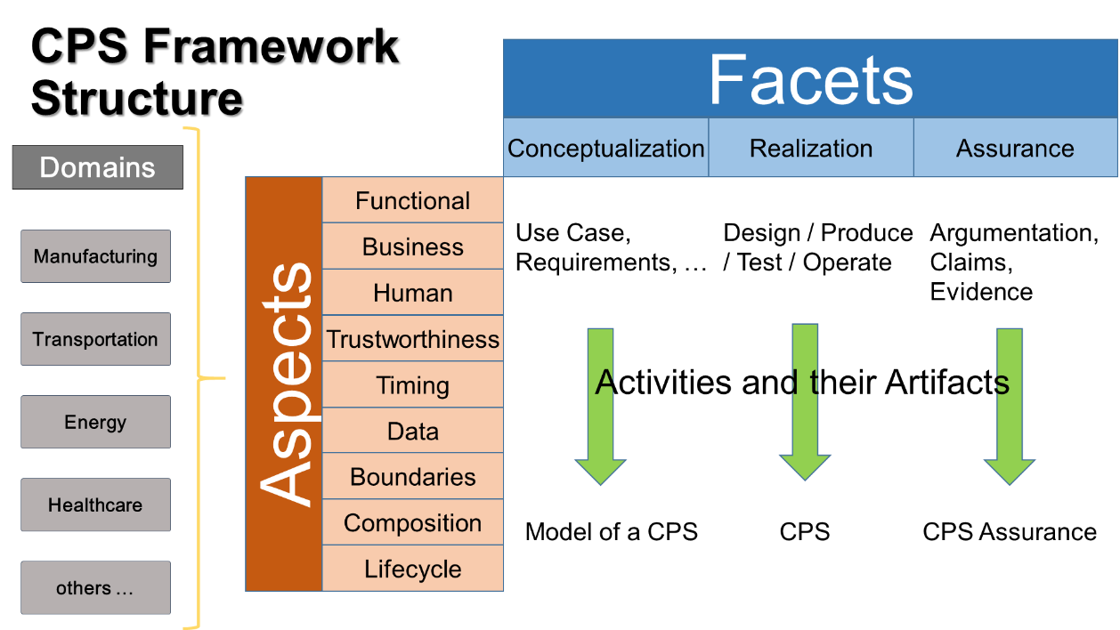
NIST CPS Framework
‘Concern-driven’: holistic, integrated approach to CPS/IoT concerns.
CPS Framework Release 1.0 (May2016) available at https://pages.nist.gov/cpspwg/

Slide 4
5.13 Analyzing and Developing CPS: Decomposition
Safety “Properties” of a Function: Automatic Emergency Braking (AEB)
CPS/Function Types
Business Case
Vehicle provides automated collision safety function
Use Case ‘feature’
Vehicle provides/maintains safe stopping
Functional Decomposition (Logical and Physical)
CPS
Braking function reacts as required
Logical
Stopping algorithm provides safe stopping
Functional Decomposition/Allocation
Messages
Messaging function receives distance to obstacles and speed from propulsion function
Info
Distance and speed info is understood by braking function
Physical
Influences
Friction function provides appropriate friction, depending on the road, tire pressure, etc.
Energy
*transductions
Apply Aspects/Concerns
Generate System Properties

Slide 5
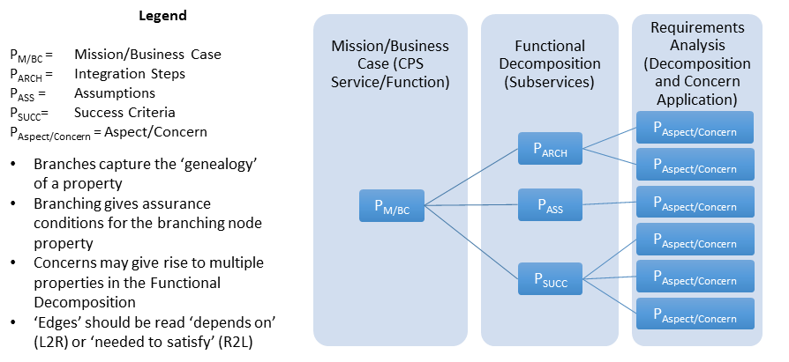
6.1.6 Mathematics of CPS Framework
Property-Tree of a CPS
Semantics of CPS Framework
… defines composition of concerns
Formal Methods for Assurance of a CPS

Slide 6

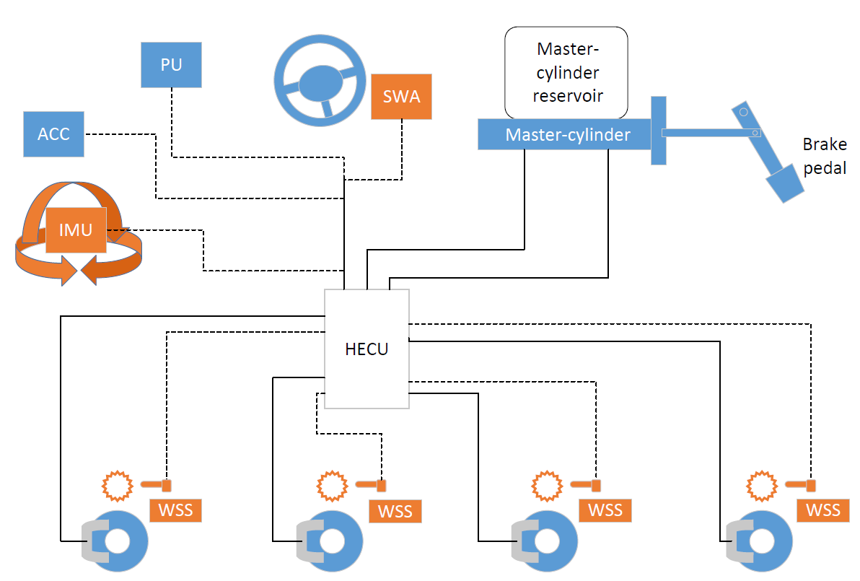
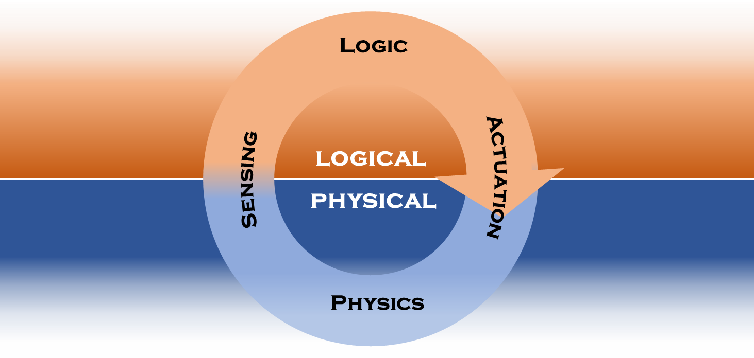

CPS Interactions: Vehicle Braking Example
Tele-
Matics
Internet
Physical connection
Steering
Wheel
Angle
Sensor
Direct logical connection
Power
Unit
PU
CAN (logical connection bus)
Adaptive
Cruise
Control
Physical element
ACC
Logical element
Brake
Pedal
Physical & logical system
IMU
Inertial
Measurement
Unit
HECU
Hydraulic Electronic Control Unit
Wheel
Speed
Sensor
Disc
Brake
Derived from original figure by Ricardo
www.ricardo.com

Slide 7
CPS Threat Defense
CPS mission success depends upon three distinct types of system interactions: cyber/logical, physical and cyber-physical interactions. CPS threats and mitigations are larger surfaces.
Primary Impact of Failure
Digital | Physical
Mitigation Mechanisms
Digital | Analog | Physical
IT System
CPS
“E.g. Better trustworthiness through combined logic and physics!”

Slide 8
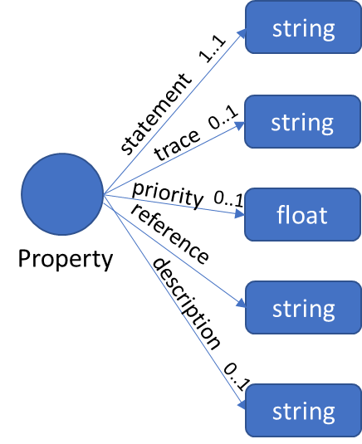
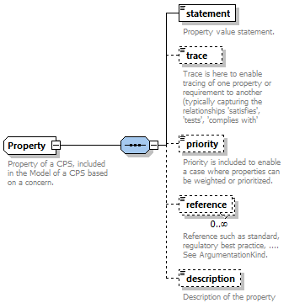
CPS Framework Modeling Tools
OWL
UML
XSD
Competence Questions/ Reasoning
owl:sparql
CPS Assurance Mathematics
CPS Facets: System Artifacts
xml:xsd

Slide 9
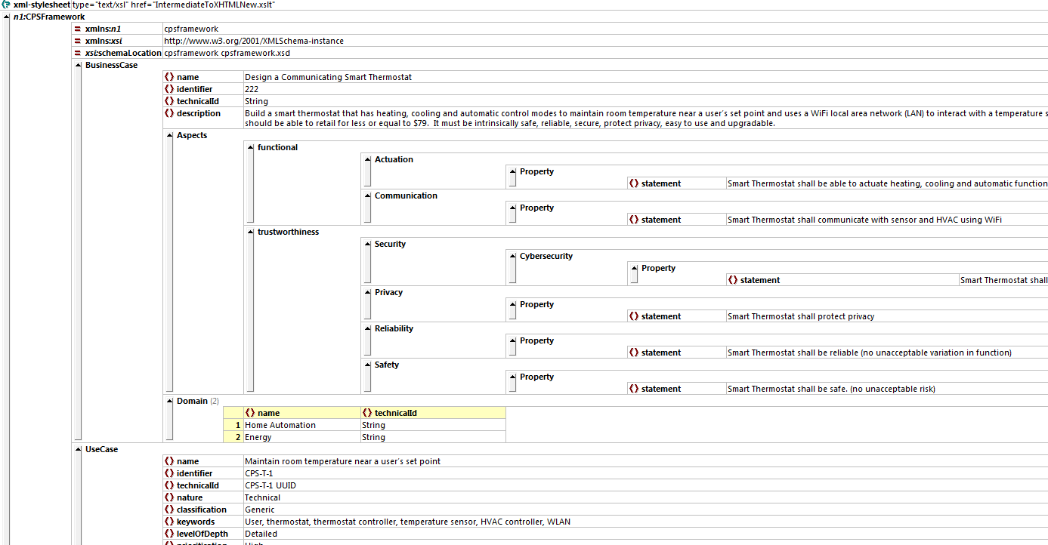
CPS Framework Model: UML/XML
Application of Trustworthiness to
each functional level of a CPS

Slide 10
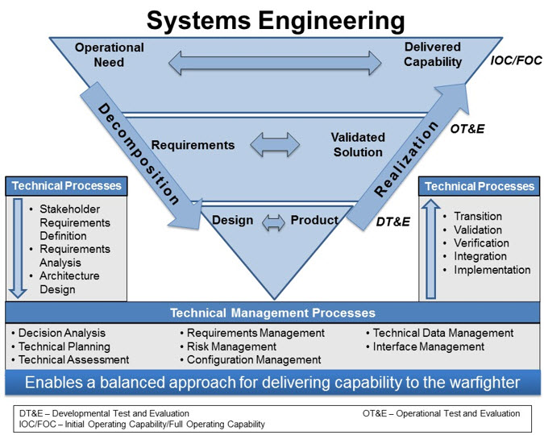
CPS Mission Analysis
CPS Framework aims to address key CPS challenges: how we conceive, design, build, deliver and maintain and protect them.
What is the CPS mission?
How was the CPS designed, built and assured? System elements?
What discipline do we need to address mission concerns?
What needs to be the core mission tools?
CPS Framework
Dashboard(s) to Exchangeable System Information

Slide 11
Facets
CPS Mission Ownership Structure
CPS Elements
High-level
Aspects
DshB Z
Cpt N
DshB C
CPS Framework Model
Cpt 2
System of Interest
Competence Questions
Engagement Levels
DshB B
Cpt 1
DshB A
Concerns &
Properties
Dashboards have scope and depth!

Slide 12
‘Competence questions’ that can be answered using the CPS Framework Model
Mission Commander: How trustworthy (interoperable, functional, etc.) is this system? How do the security features compare to those of our adversary? If we have gaps to our expected adversary, which elements of a concern are lagging behind, which mission capability officer should be responsible and what effort is required to fill those gaps?
Mission Capability Officer: What is the effort we’ve made to assure a mission concern? Where are we in the CPS execution? What’s the degree of completion? What resources can address mission gaps?
Fighter/Technician: What are the impacts on any given mission concern of replacing the encryption algorithm (or implementing any other mission plan change)? I.e., tradeoff analysis? Is there an opportunity to achieve trustworthiness targets by modifying the physics of the system?

Slide 13
Concerns/Properties
of Interest
NIST Federated CPS Testbed/UCEF
Simulation
Exp Z
Cpt N
Exp C
CPS Framework Model
Cpt 2
System of Interest
Experimenters
Exp B
Cpt 1
Exp A
Experiments and Testing have varying scope/concern coverage!

Slide 14
Some CPS Simulators
NIST/UCEF
PNNL
CMU/MIT
MS&T
Ecclipse-Based
Ptolemy (tool)
SysML (2 groups)
Mathworks (Simscape + HLA ‘Plugin’)
EP0CHS (Smart Grid Suite)

Slide 15
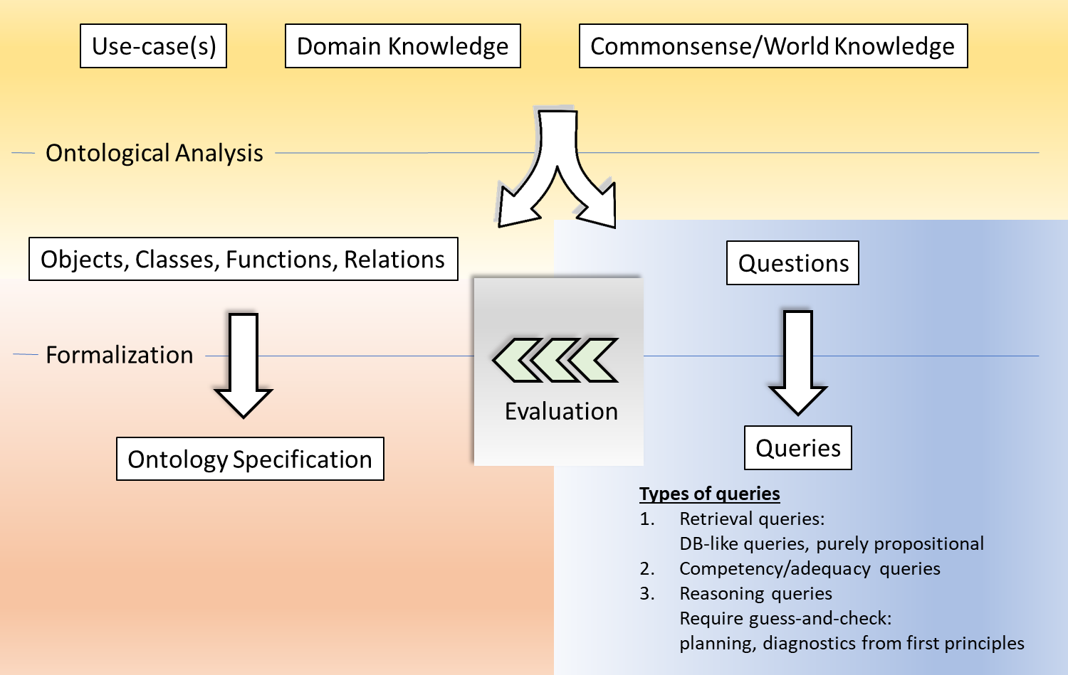
Reasoning about Trustworthiness: Discrete Method

Slide 16
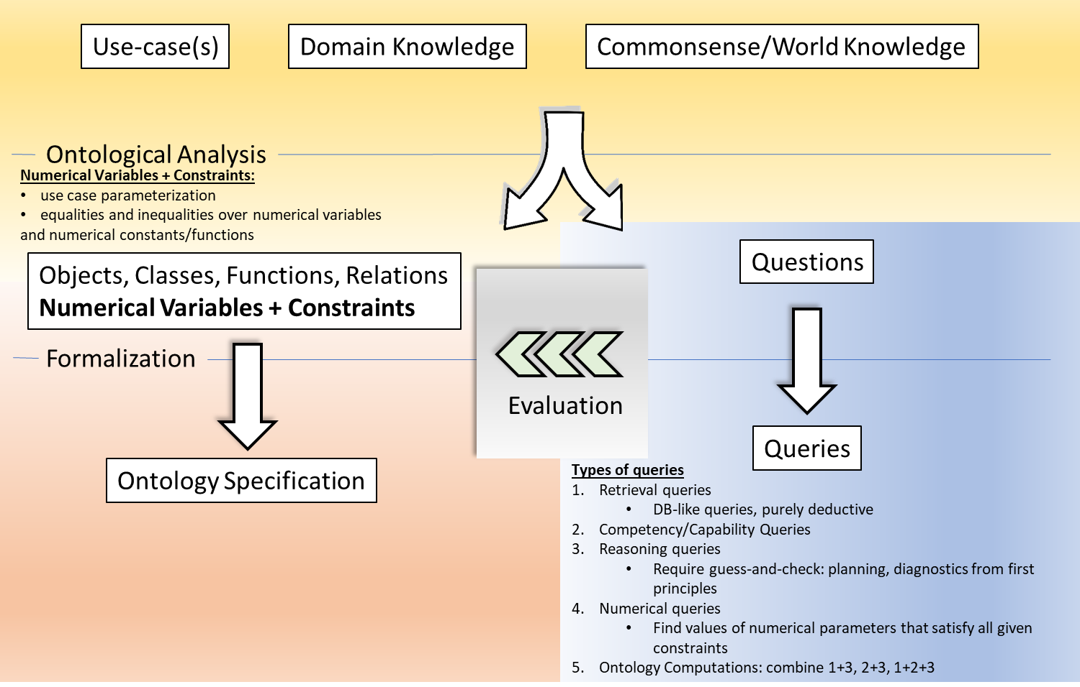
Reasoning about Trustworthiness: Parametrized Decision-Calculus

Slide 17
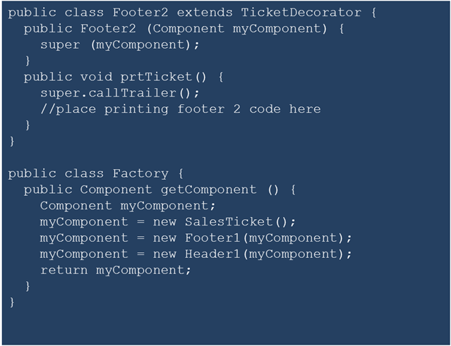
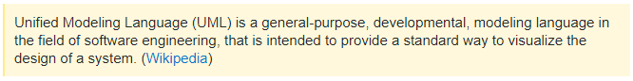
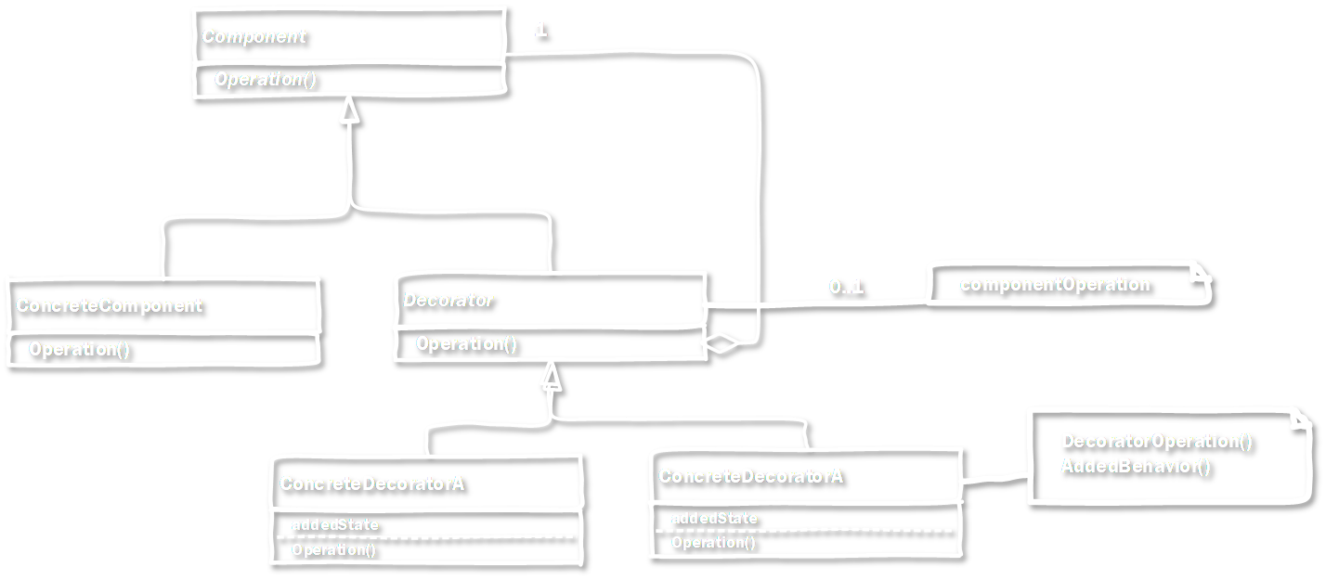
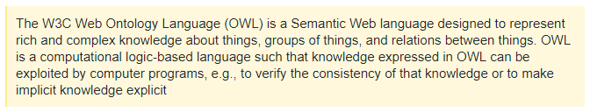
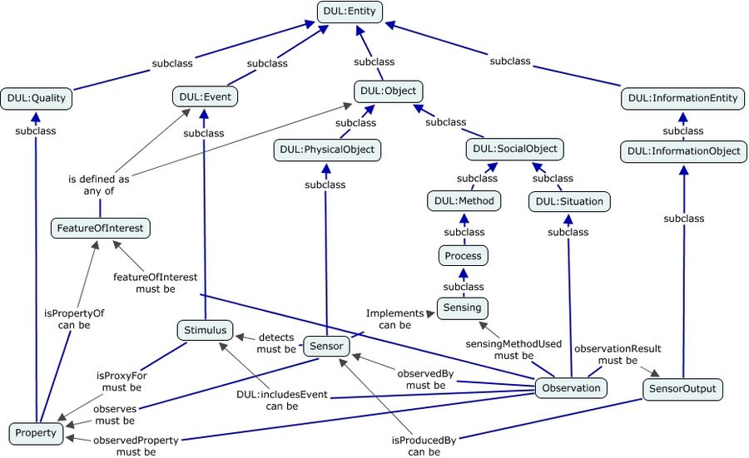
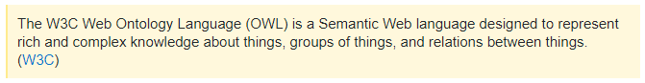
CPS Framework Modeling
UML
Focus: systems, system design, code generation
Knowledge Representation (KR) Languages, OWL
Focus: “world” knowledge, commonsense, automated reasoning

Slide 18
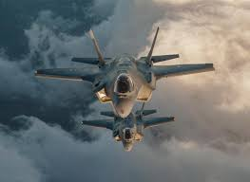
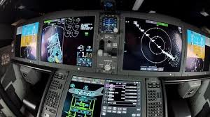
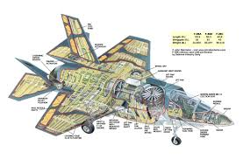
Cone-of-Impact Vulnerability Assessment

